Slide 1

Python 3
Learn difficult things in easy way
Onkar Deshpande
7 September 2017

Slide 2
Training Highlights
Session 1
Introduction to Python in Nutshell
Working with basic syntax of Python
Variables and Data types
Operators and expressions
the control flow
Looping
Strings
String Formatting
Working with Collections
List, Tuple, Set & Map
Collection based Functions
Indexing and Slicing over the collection
Working with iterator and Generators
Working with itertool module
Working with Lambda
Session 2
Introduction to Python functions
Working with functions
Working with magic functions
Working with *args and **kwargs
Introduction to Object oriented with Python
Class and Objects
__init__
Inheritance in Python
Working with Enums
Exception & Error handling
With statement
Working with Modules
Working with re module (Regex)
Working with math module
Working with datatime module
working with random module

Slide 3
Training Highlights
Session 3
Working with Modules continues …
Working with JSON module
Working with excel
Working with logging
Working with zip module
Creating python packages
Connecting python with Database
Session 4
Introduction to Multithreading
Python Networking (Paramiko module)
Working with Requests module
Ptyhon performance tips

Slide 4
What’s Python
Python is…
Programing language like Java, C, Perl, Ruby, etc
Easy to run because of cross platform scripting language
Clear look & feel thanks to language design and culture hating magic's
Able do anything (multi-purpose glue language) except writing OS/drivers
Used everywhere e.g. in Amazon, Google, Yahoo, Dropbox, NASA, etc.

Slide 5
Most attractive features
Batteries included
Web server, database, GUI, networking, regex, XML, JSON, archiving, C/C++ integration, thread/process pooling, async I/O, serialization, etc.
More batteries invented
Intelligences are innovating technologies all over the world day by day.
You can try the innovations using pip through the Internet.
Easier than English
Even I can write Python codes better than English email.
All you need is not LOVE but intelligence with a little knowledge about Python.
Notes:
Easy to learn, easy to read and easy to maintain.
Portable: It can run on various hardware platforms and has the same interface on all platforms.
Extendable: You can add low-level modules to the Python interpreter.
Scalable: Python provides a good structure and support for large programs.
Python has support for an interactive mode of testing and debugging.
Python has a broad standard library cross-platform.
Everything in Python is an object: variables, functions, even code. Every object has an ID, a type, and a value.
Python provides interfaces to all major commercial databases.
Python supports functional and structured programming methods as well as OOP.
Python provides very high-level dynamic data types and supports dynamic type checking.
Python supports GUI applications
Python supports automatic garbage collection.
Python can be easily integrated with C, C++, and Java.

Slide 6

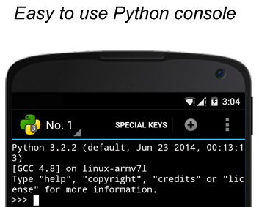



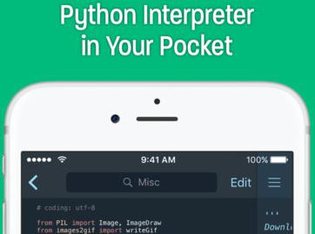
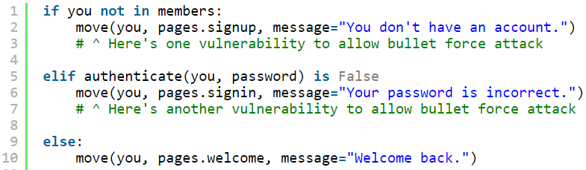
My favorites
Python runs everywhere
Python allows me to explain things very clearly

Slide 7

A bit more about Python
History of Python
Created in 1989 by Guido Van Rossum
Python 2.7 released in 2010
Python 3.6 released in 2017
PEP 404 - No 2.8 planned
PEP 373 - EOL of 2.7 planed in 2020

Slide 8
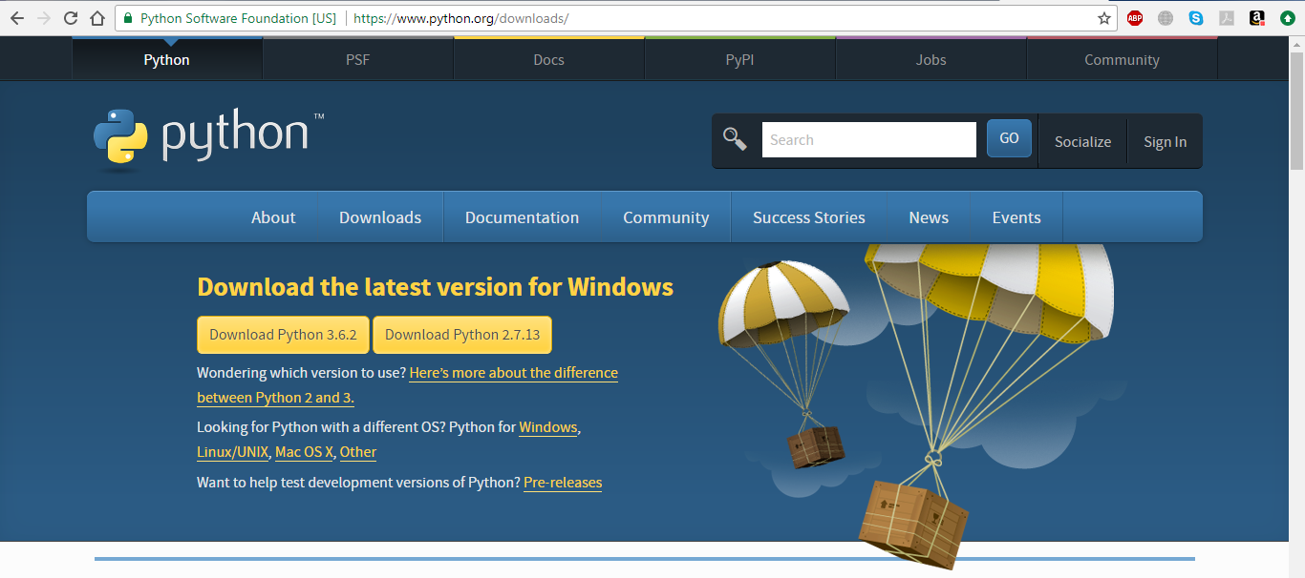
Download & setup Python 3.6.*

Slide 9
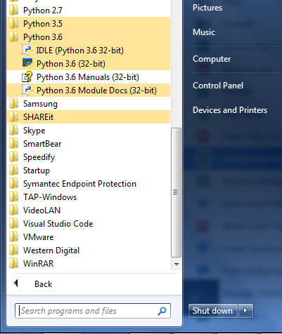
Run Python Shell

Slide 10
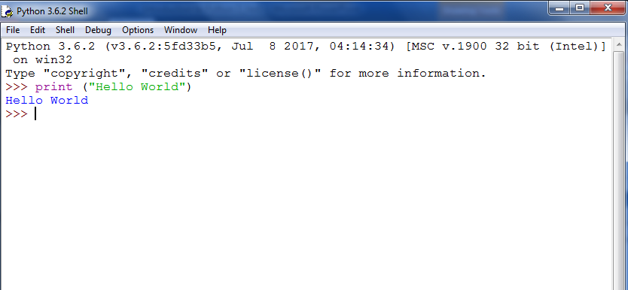
Hello World

Slide 11
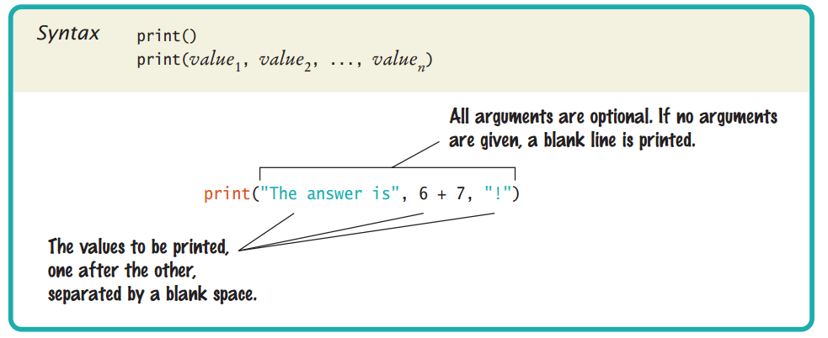
Print Function Syntax

Slide 12

Python Code Execution
Python’s traditional runtime execution model: source code you type is translated to byte code, which is then run by the Python Virtual Machine. Your code is automatically compiled, but then it is interpreted.
Source code extension is .py
Byte code extension is .pyc (compiled python code)
Notes:
Most probably you will have read somewhere that the Python language is an interpreted programming or a script language. The truth is: Python is both an interpreted and a compiled language. But calling Python a compiled language would be misleading. (At the end of this chapter, you will find the definitions for Compilers and Interpreters, if you are not familiar with the concepts!) People would assume that the compiler translates the Python code into machine language. Python code is translated into intermediate code, which has to be executed by a virtual machine, known as the PVM, the Python virtual machine. This is a similar approach to the one taken by Java. There is even a way of translating Python programs into Java byte code for the Java Virtual Machine (JVM). This can be achieved with Jython. The question is, do I have to compile my Python scripts to make them faster or how can I compile them? The answer is easy: Normally, you don't need to do anything and you shouldn't bother, because "Python" is doing the thinking for you, i.e. it takes the necessary steps automatically.

Slide 13
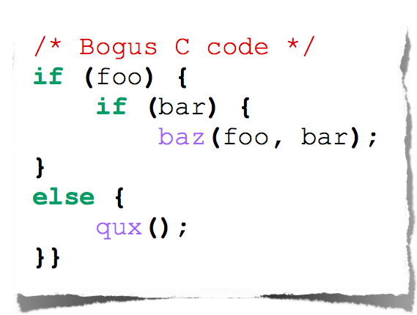
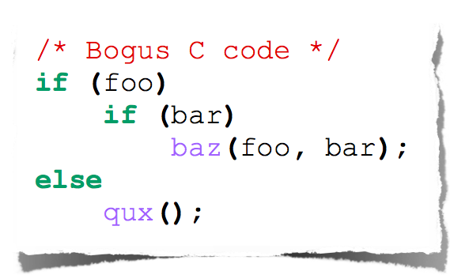
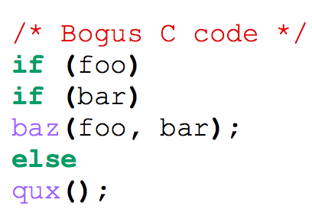
Indentation
How many of us believe in indentation?
Do we really bother of such things?
Lets see some sample code

Slide 14
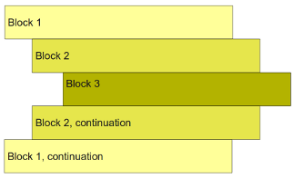
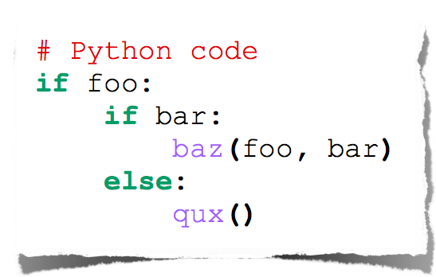
Indentation
Python works with indentation closely
Python expects you should always be explicit whenever you write code.

Slide 15






Working with IDE’s
Emacs
Vim
Komodo
PyCharm
Eclipse (PyDev)
NetBeans
and many more …

Slide 16
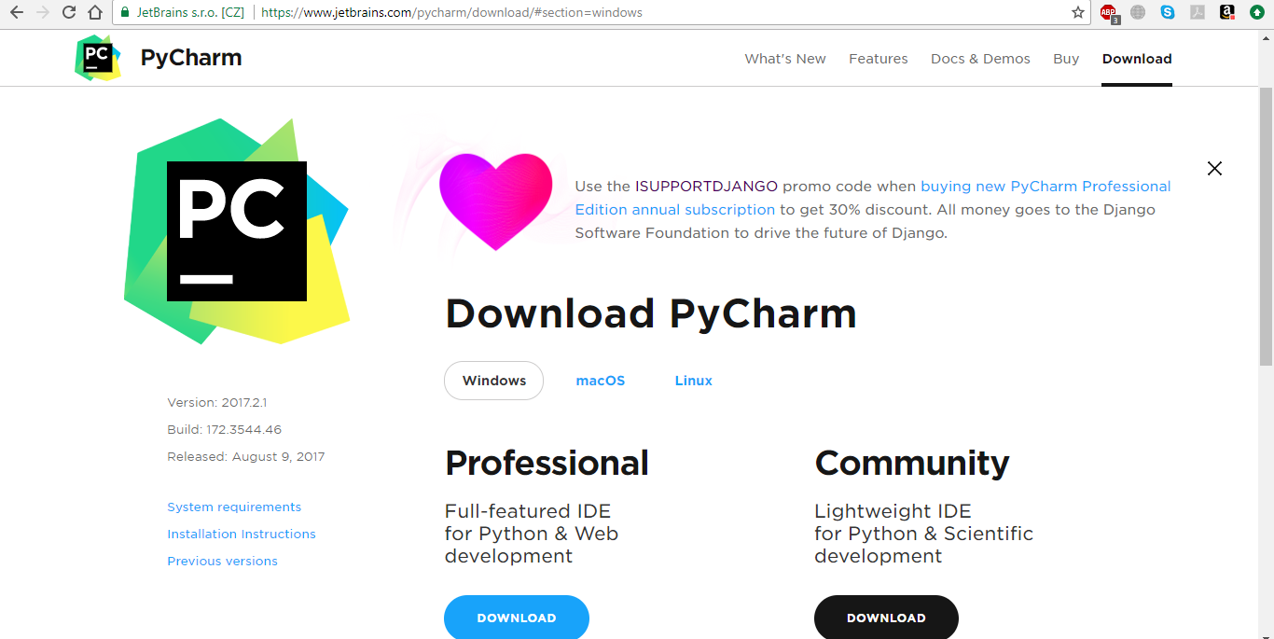
Setting up PyCharm

Slide 17
Lets Work with python
Variables, Operators & Expression,Data Types, Loops, Collections

Slide 18
Variables
In Python we don’t specify what kind of data we are going to put in a variable.
You can even assign values to multiple variables in a single line.
a= 45 name= "Onkar" print (a) print (name)
a, b = 45, 54 print (a) print (b)

Slide 19
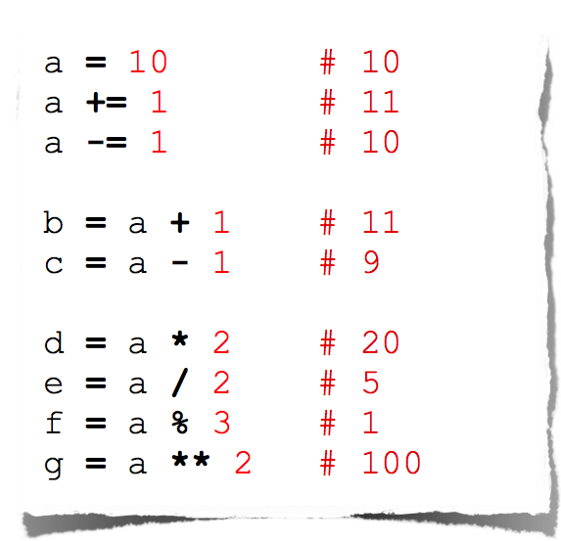
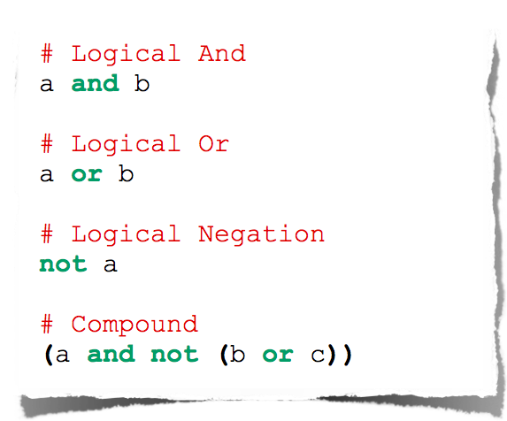
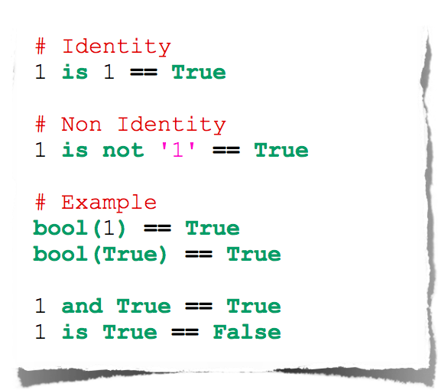
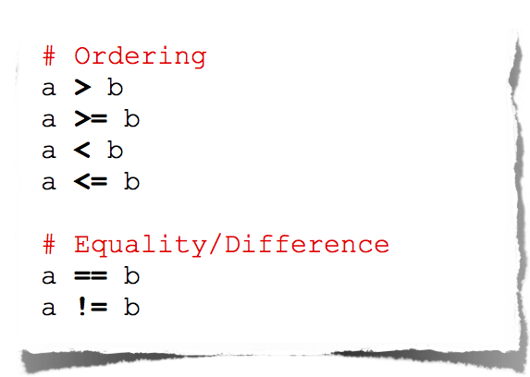
Operators & Expression

Slide 20
Numbers
Numbers are Immutable objects in Python that cannot change their values.
There are two built-in data types for numbers in Python3:
Integer (int)
Floating-point numbers (float)
Common Number Functions
Function | Description
int(x) | to convert x to an integer
float(x) | to convert x to a floating-point number
abs(x) | The absolute value of x
cmp(x,y) | -1 if x < y, 0 if x == y, or 1 if x > y
exp(x) | The exponential of x: e^{x}
log(x) | The natural logarithm of x, for x> 0
pow(x,y) | The value of x**y
sqrt(x) | The square root of x for x > 0

Slide 21
Booleans
The Boolean data type can be one of two values, either True or False. We use Booleans in programming to make comparisons and to control the flow of the program.
# This is Boolean Example is_python = True print(is_python) # Everything in Python can be cast to Boolean my_name = "Onkar Deshpande" is_name_inside = bool(my_name) print("Name is available", is_name_inside) # All of following things are equivalent to False these_are_false = False or 0 or "" or {} or [] or None print(these_are_false) # Most everything else is equivalent to True these_are_true = True and 1 and "Test" and {'name':'onkar'} and ['sachin','rahul'] print(these_are_true)

Slide 22
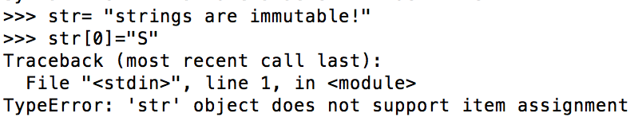
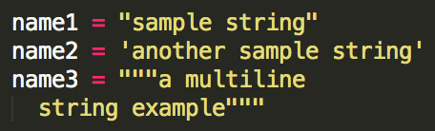
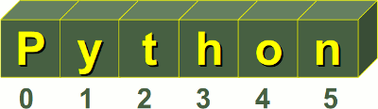
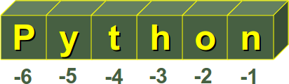
Strings
Python Strings are Immutable objects that cannot change their values.
You can update an existing string by (re)assigning a variable to another string.
Python does not support a character type; these are treated as strings of length one.
Python accepts single ('), double (") and triple (''' or """) quotes to denote string literals.
String indexes starting at 0 in the beginning of the string and working their way from -1 at the end.

Slide 23
Common String Methods
Method | Description
str.count(sub, beg= 0,end=len(str)) | Counts how many times sub occurs in string or in a substring of string if starting index beg and ending index end are given.
str.isalpha() | Returns True if string has at least 1 character and all characters are alphanumeric and False otherwise.
str.isdigit() | Returns True if string contains only digits and False otherwise.
str.lower() | Converts all uppercase letters in string to lowercase.
str.upper() | Converts lowercase letters in string to uppercase.
str.replace(old, new) | Replaces all occurrences of old in string with new.
str.split(str=‘ ’) | Splits string according to delimiter str (space if not provided) and returns list of substrings.
str.strip() | Removes all leading and trailing whitespace of string.
str.title() | Returns "titlecased" version of string.

Slide 24
String function examples
number = "5" letters = "abcdef"
print(number.isnumeric()) print(letters.isnumeric())
Output:
True
False
movie = "2001: A SAMMY ODYSSEY" book = "A Thousand Splendid Sharks" poem = "sammy lived in a pretty how town"
print(movie.islower()) print(movie.isupper()) print(book.istitle()) print(book.isupper()) print(poem.istitle()) print(poem.islower())
Output:
False
True
True
False
False
True
balloon = "Sammy has a balloon."
print(" ".join(balloon)) print("".join(reversed(balloon))) print(balloon.split()) print(balloon.replace("has","had")) print(",".join(["sharks", "crustaceans", "plankton"]))
Output:
S a m m y h a s a b a l l o o n .
.noollab a sah ymmaS
['Sammy', 'has', 'a', 'balloon.']
Sammy had a balloon.
sharks,crustaceans,plankton

Slide 25
String Formatting Example
# Basic formatting print('{} {}'.format('one', 'two')) print('{1} {0}'.format('one', 'two')) # Padding and aligning strings # Right print('{:>10}'.format('test')) # Left print('{:10}'.format('test')) # Padding with Character print('{:_<10}'.format('test')) # Center print('{:^10}'.format('test')) # Truncating long strings print('{:.5}'.format('xylophone')) # Combining truncating and padding print('{:^10.5}'.format('xylophone'))
Output:
one two
two one
OutPut:
test
Output:
test :
Output:
test______
Output:
: test :
Output:
xylop
Output:
: xylop :
For more formatting info please visit

Slide 26
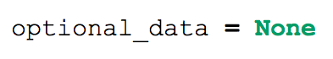
Null

Slide 27
Working with Collections
List, Tuple, Set, Dictionary

Slide 28
List
A list is a data structure in Python that is a mutable, or changeable, ordered sequence of elements.
Each element or value that is inside of a list is called an item.
Just as strings are defined as characters between quotes, lists are defined by having values between square brackets [ ].

Slide 29
Working with List
# Create List xor_employee = ['Onkar', 'Ashish', 'Rahul', 'Amit', 'Kedar', 'Sanket'] print(xor_employee) # Indexing Lists print(xor_employee[2]) print(xor_employee[-1]) # Modifying Items in Lists xor_employee[1] = "Sunil"
# Slicing Lists print(xor_employee[1:4]) # if we want to print the first 3 items of the list print(xor_employee[:3]) # Include all the items at the end of a list start with 3 index print(xor_employee[3:]) # Working with negative index numbers when slicing lists print(xor_employee[-4:-2]) print(xor_employee[-3:]) # stride parameter numbers = [0, 1, 2, 3, 4, 5, 6, 7, 8, 9, 10, 11, 12] print(numbers[1:11:2]) print(numbers[::2])

Slide 30
Working with List continue…
# Modifying Lists with Operators xor_employee = ['Onkar', 'Ashish', 'Rahul', 'Amit', 'Kedar', 'Sanket'] xor_location = ['Mumbai', 'Pune', 'Gurugaram', 'Kolkata', 'Nasik'] print(xor_employee + xor_location) # Adding Single Item xor_employee = xor_employee + ['Rakhi'] print(xor_employee) # Replicate lists using multiplication print(xor_location * 2)
# Removing an Item from a List xor_location = ['Mumbai', 'Pune', 'Gurugaram', 'Kolkata', 'Nasik'] del xor_location[3] print(xor_location) del xor_location[1:3] print(xor_location) # Constructing a List with List Items xor_department =[['HR','L&D'],['Admin','Sysnet']] print(xor_department)

Slide 31
Working with list methods
# List Methods xor_employee = ['Onkar', 'Ashish', 'Rahul', 'Amit', 'Kedar', 'Sanket'] # list.append() xor_employee.append('Rakhi') print(xor_employee) # list.insert() xor_employee.insert(0,'Kiran') print(xor_employee) # list.extend() xor_new_employee = ['Kirti','Ved','Adarsh'] xor_employee.extend(xor_new_employee) print(xor_employee) # list.remove() xor_employee.remove('Rahul') print(xor_employee)

Slide 32
Working with list methods
# list.pop() print(xor_employee.pop(1)) print(xor_employee) # list.index() print(xor_employee) print(xor_employee.index('Amit')) # list.copy() xor_2nd_copy_employee= xor_employee.copy() print(xor_2nd_copy_employee) # list.reverse() xor_employee.reverse() print(xor_employee)
# list.count() print(xor_employee.count('Sanket')) # list.sort() xor_employee.sort() print(xor_employee) # list.clear() xor_employee.clear()

Slide 33
Tuples
A tuple is a data structure that is an immutable, or unchangeable, ordered sequence of elements. Because tuples are immutable, their values cannot be modified.
os_name = ('Fedora', 'Debian', 'Kubuntu', 'Pardus‘) print(os_name) #('Fedora', 'Debian', 'Kubuntu', 'Pardus') print (os_name[1]) # 'Debian' for x in os_name: print(x) #Fedora Debian Kubuntu Pardus del os_name[0] # TypeError: 'tuple' object doesn't support item deletion

Slide 34
Set
A set is an unordered collection of items. Every element is unique (no duplicates) and must be immutable (which cannot be changed).
A set is created by placing all the items (elements) inside curly braces {}, separated by comma or by using the built-in function set().
my_set = {1, 2, 3}
Empty curly braces {} will make an empty dictionary in Python. To make a set without any elements we use the set() function without any argument.
my_set2 = set()

Slide 35
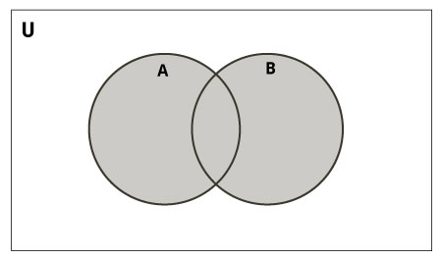
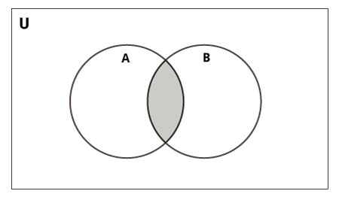
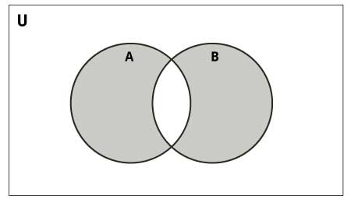
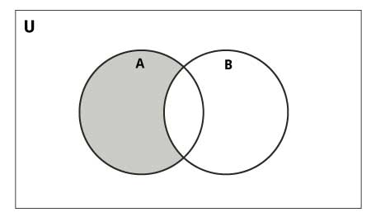
Mathematical set operations
Union
Intersection
# initialize A and B A = {1, 2, 3, 4, 5} B = {4, 5, 6, 7, 8} # use | operator for Union # Output: {1, 2, 3, 4, 5, 6, 7, 8} print(A | B)
# initialize A and B A = {1, 2, 3, 4, 5} B = {4, 5, 6, 7, 8} # use | operator for Intersection # Output: {4, 5} print(A & B)
Symmetric Difference
Difference
# initialize A and B A = {1, 2, 3, 4, 5} B = {4, 5, 6, 7, 8} # use | operator Symmetric Diff
# Output: {1, 2, 3, 6, 7, 8} print(A ^ B)
# initialize A and B A = {1, 2, 3, 4, 5} B = {4, 5, 6, 7, 8} # use | operator for Difference # Output: {1, 2, 3} print(A - B)

Slide 36
Python Set Methods
Method | Description
add() | Add an element to a set
clear() | Remove all elements form a set
copy() | Return a shallow copy of a set
difference() | Return the difference of two or more sets as a new set
difference_update() | Remove all elements of another set from this set
discard() | Remove an element from set if it is a member. (Do nothing if the element is not in set)
intersection() | Return the intersection of two sets as a new set
intersection_update() | Update the set with the intersection of itself and another
Method | Description
isdisjoint() | Return True if two sets have a null intersection
issubset() | Return True if another set contains this set
pop() | Remove and return an arbitary set element. Raise KeyErrorif the set is empty
remove() | Remove an element from a set. If the element is not a member, raise a KeyError
symmetric_difference() | Return the symmetric difference of two sets as a new set
symmetric_difference_update() | Update a set with the symmetric difference of itself and another
union() | Return the union of sets in a new set
update() | Update a set with the union of itself and others

Slide 37
Python Frozenset
Frozenset is a new class that has the characteristics of a set, but its elements cannot be changed once assigned. While tuples are immutable lists, frozensets are immutable sets.
Sets being mutable are unhashable, so they can't be used as dictionary keys. On the other hand, frozensets are hashable and can be used as keys to a dictionary.
Frozensets can be created using the function frozenset().
This datatype supports methods like copy(), difference(), intersection(), isdisjoint(), issubset(), issuperset(), symmetric_difference() and union(). Being immutable it does not have method that add or remove elements.
Example
# initialize A and B A = frozenset([1, 2, 3, 4]) B = frozenset([3, 4, 5, 6])

Slide 38
Dictionary in Python
The dictionary is Python’s built-in mapping type. Dictionaries map keys to values and these key-value pairs provide a useful way to store data in Python.
dictionaries are constructed with curly braces on either side { }.

Slide 39
Work with Dictionary
student_details = {'Name': 'Zara', 'Age': 7, 'Class': 'First'} print("student_details['Name']: ", student_details['Name']) print("student_details['Age']: ", student_details['Age']) # Updating Dictionary student_details['Age'] = 8 # update existing entry student_details['School'] = "DPS School" # Add new entry print("student_details['Age']: ", student_details['Age']) print("student_details['School']: ", student_details['School']) # Delete Dictionary Elements del student_details['Name'] # remove entry with key 'Name' student_details.clear() # remove all entries in dict del student_details # delete entire dictionary print("student_details['Age']: ", student_details['Age']) print("student_details['School']: ", student_details['School'])

Slide 40
Dictionaries methods
Method | Description
dict.clear() | Removes all elements of dictionary dict
dict.copy() | Returns a shallow copy of dictionary dict
dict.fromkeys() | Create a new dictionary with keys from seq and values set to value.
dict.get(key, default=None) | For key key, returns value or default if key not in dictionary
dict.has_key(key) | Removed, use the in operation instead.
dict.items() | Returns a list of dict's (key, value) tuple pairs
dict.keys() | Returns list of dictionary dict's keys
dict.setdefault(key, default = None) | Similar to get(), but will set dict[key] = default if key is not already in dict
dict.update(dict2) | Adds dictionary dict2's key-values pairs to dict
dict.values() | Returns list of dictionary dict's values

Slide 41
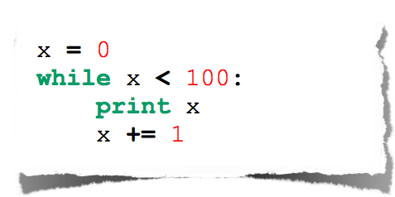
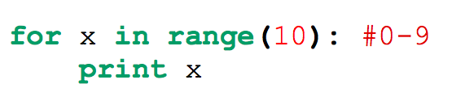
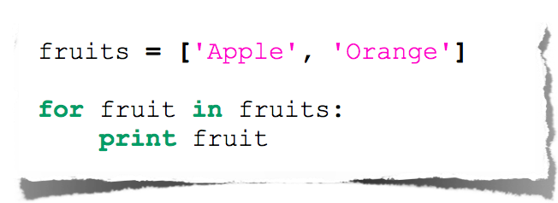
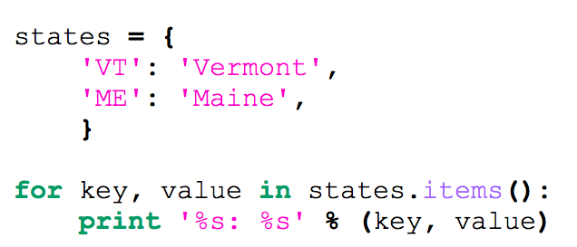
Loops in Python

Slide 42
Reading Input
number = int(input("Enter an integer: "))
if number < 100:
print("Your number is smaller than 100")
else:
print("Your number is greater than 100")

Slide 43
Working with functions
Basic function, default args, keyword args ,*args & *kargs

Slide 44
Basic Function
#Syntax
def functionname(params):
statement1
statement2
def sum(a, b):
return a + b
res = sum(234234, 34453546464)
print (res)

Slide 45
Local and global variables
def change(b):
a = 90
print(a)
a = 9
print("Before the function call ", a)
print("inside change function")
change(a)
print("After the function call ", a)

Slide 46
Local and global variables continue…
def change(b):
global a
a = 90
print(a)
a = 9
print("Before the function call ", a)
print("inside change function")
change(a)
print("After the function call ", a)

Slide 47
Default argument value
In a function variables may have default argument values, that means if we don’t give any value for that particular variable it will assigned automatically.
def test(a , b=-99):
if a > b:
return True
else:
return False
print test(12, 23)
print test(12)

Slide 48
Keyword arguments
def func(a, b=5, c=10):
print('a is', a, 'and b is', b, 'and c is', c)
func(12, 24)
# a is 12 and b is 24 and c is 10
func(12, c = 24)
# a is 12 and b is 5 and c is 24
func(b=12, c = 24, a = -1)
# a is -1 and b is 12 and c is 24

Slide 49
*args and **kwargs in python
*args and **kwargs allow you to pass a variable number of arguments to a function.
*args is used to send a non-keyworded variable length argument list to the function.
**kwargs allows you to pass keyworded variable length of arguments to a function.

Slide 50
Working with *args & **kwargs
def test_var_args(f_arg, *names): print ('first normal arg:', f_arg) for name in names: print ('another arg through *argv :', name) test_var_args('Onkar','Rahul','Sachin','Laxman')
def greet_me(**kwargs): if kwargs is not None: for key, value in kwargs.items(): print(key, "==", value) greet_me(name='Onkar')

Slide 51
Working with *args & **kwargs contiues
def test_args_kwargs(arg1, arg2, arg3): print ("arg1:", arg1) print ("arg2:", arg2) print ("arg3:", arg3) args = ("two", 3,5) test_args_kwargs(*args)
def test_args_kwargs(arg1, arg2, arg3): print ("arg1:", arg1) print ("arg2:", arg2) print ("arg3:", arg3) kwargs = {"arg3": 3, "arg2": "two","arg1":5} test_args_kwargs(**kwargs)

Slide 52
Exception Handling
Exception, try catch, finally , raise

Slide 53
Types of Error in Python
NameError
When one starts writing code, this will be one of the most command exception he/she will find. This happens when someone tries to access a variable which is not defined.
Example : print (Onkar)
TypeError
TypeError is also one of the most found exception. This happens when someone tries to do an operation with different kinds of incompatible data types. A common example is to do addition of Integers and a string.
Example : print (1 + “Onkar")

Slide 54
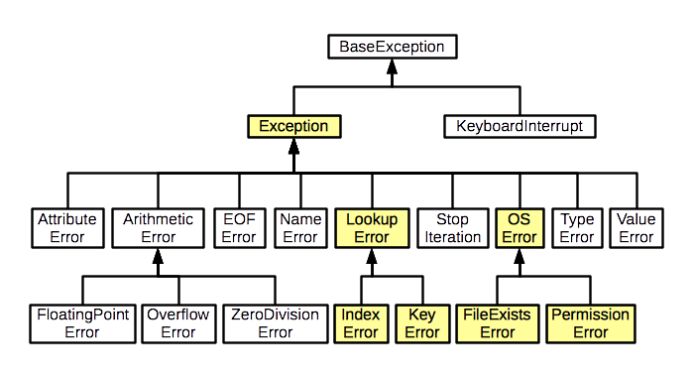
Exception Hierarchy

Slide 55
How to handle exceptions?
Basic Syntax
try:
statements to be inside try clause
statement2
statement3
except ExceptionName:
statements to evaluated in case of ExceptionName happens

Slide 56
Example
def get_number():
"Returns a float number"
number = float(input("Enter a float number: "))
return number
while True:
try:
print(get_number())
except TypeError:
print("You entered a wrong value.")
except:
print("Unknown Error.")

Slide 57
Raising exceptions
try:
raise ValueError("A value error happened.")
except ValueError:
print("ValueError in our code.")

Slide 58
Using finally for cleanup
try:
fobj = open("hello.txt", "w")
res = 12 / 0
except ZeroDivisionError:
print("We have an error in division")
finally:
fobj.close()
print("Closing the file object.")

Slide 59
Classes & objects
Oops terminology, creating class, inheritance

Slide 60
Overview of OOP Terminology
Class − is user-defined prototype for an object that defines a set of attributes & methods.
Class variable − A variable that is shared by all instances of a class.
Data member − A class variable or instance variable that holds data associated with a class and its objects.
Function overloading − The assignment of more than one behavior to a particular function.
Instance variable − A variable that is defined inside a method and belongs only to the current instance of a class.
Inheritance − The transfer of the characteristics of a class to other classes that are derived from it.
Instance − An individual object of a certain class. An object obj that belongs to a class Circle, for example, is an instance of the class Circle.
Instantiation − The creation of an instance of a class.
Object − A unique instance of a data structure that is defined by its class.

Slide 61
first class
Sytnax
class nameoftheclass(parent_class):
statement1
statement2
statement3
class MyClass(object):
a = 90
b = 88
p = MyClass()
print p

Slide 62
Dunder Methods
In Python, special methods are a set of predefined methods you can use to enrich your classes. They are easy to recognize because they start and end with double underscores, for example __init__ or __str__.
As it quickly became tiresome to say under-under-method-under-under Python community adopted the term “dunder methods”, a short form of “double under.”
Lets work with dunder method with class…

Slide 63
Object Initialization: __init__
class Account: """A simple account class""" def __init__(self, owner, amount=0): """ This is the constructor that lets us create objects from this class """ self.owner = owner self.amount = amount self._transactions = [] acc = Account('bob') # default amount = 0 acc = Account('bob', 10) print ("Owner name = ",acc.owner, "Amount ",acc.amount) #Owner name = bob Amount 10

Slide 64
Object Representation: __str__, __repr__
class Account: # ... (see above) def __repr__(self): return 'Account({!r}, {!r})'.format(self.owner, self.amount) def __str__(self): return 'Account of {} with starting amount: {}'.format( self.owner, self.amount) acc = Account('bob', 10) print(acc) print(repr(acc))
#Account of bob with starting amount: 10
#Account('bob', 10)

Slide 65
dunder methods
Python has many dunder methods, Python class with various dunder methods are useful to unlock the following language features:
Initialization of new objects
Object Initialization: __init__
Object representation
Object Representation: __str__, __repr__
Enable iteration
Iteration: __len__, __getitem__, __reversed__
Operator overloading (comparison)
Operator Overloading :__eq__, __lt__
Operator overloading (addition)
Operator Overloading :__add__
Method invocation
Callable Python Objects: __call__
Context manager support (with statement)
With Statement: __enter__, __exit__
For more details visit

Slide 66
class BankAccount(): autoAccountNoGen = 0 def __init__(self, accountHolderName, accountBalance): BankAccount.autoAccountNoGen += 1 self.__accountNo = BankAccount.autoAccountNoGen self.accountHolderName = accountHolderName self._accountBalance = accountBalance def __str__(self): return "Account no = {} " \ "Account Holder Name = {} " \ "Account Balance = {}" \ .format(self.__accountNo, self.accountHolderName, self._accountBalance) def withdraw(self, amount): if self.accountBalance - amount <= 500: raise RuntimeError("Your Balance can not be less than 500") else: self.accountBalance -= amount return self.accountBalance def deposit(self, amount): self.accountBalance += amount return self.accountBalance
Staic variable
private variable
Protected variable

Slide 67
Inheritance
Person
Student
Teacher

Slide 68
Person class
class Person(object):
"""
Returns a ```Person``` object with given name.
"""
def __init__(self, name):
self.name = name
def get_details(self):
"Returns a string containing name of the person"
return self.name

Slide 69
Student class
class Student(Person):
"""
Returns a ```Student``` object, takes 3 arguments, name, branch, year.
"""
def __init__(self, name, branch, year):
Person.__init__(self, name)
self.branch = branch
self.year = year
def get_details(self):
"Returns a string containing student's details."
return "%s studies %s and is in %s year." % (self.name, self.branch, self.year)

Slide 70
Teacher Class
class Teacher(Person):
"""
Returns a ```Teacher``` object, takes a list of strings (list of papers) as argument.
"""
def __init__(self, name, papers):
Person.__init__(self, name)
self.papers = papers
def get_details(self):
return "%s teaches %s" % (self.name, ','.join(self.papers))

Slide 71
Execute code
person1 = Person('Sachin')
student1 = Student('Kushal', 'CSE', 2005)
teacher1 = Teacher('Prashad', ['C', 'C++'])
print(person1.get_details())
print(student1.get_details())
print(teacher1.get_details())

Slide 72
Multiple Inheritance
class MyClass(Parentclass1, Parentclass2,...):
def __init__(self):
Parentclass1.__init__(self)
Parentclass2.__init__(self)
...
...

Slide 73
Iterators
We use for statement for looping over a list.
If we use it with a string, it loops over its characters.
>>> for i in [1, 2, 3, 4]: ... print i, ... 1 2 3 4
>>> for c in "python": ... print c ... p y t h o n
If we use it with a file, it loops over lines of the file.
>>> for k in {"x": 1, "y": 2}: ... print k ... y x
There are many types of objects which can be used with a for loop. These are called iterable objects.

Slide 74
Iterators continue…
There are many functions which consume these iterables.
>>> ",".join(["a", "b", "c"]) 'a,b,c' >>> ",".join({"x": 1, "y": 2}) 'y,x' >>> list("python") ['p', 'y', 't', 'h', 'o', 'n'] >>> list({"x": 1, "y": 2}) ['y', 'x']

Slide 75
The Iteration Protocol
The built-in function iter takes an iterable object and returns an iterator.
>>> x = iter([1, 2, 3]) >>> x <listiterator object at 0x1004ca850> >>> x.next() 1 >>> x.next() 2 >>> x.next() 3
Each time we call the next method on the iterator gives us the next element.
If there are no more elements

Slide 76
Implement Iterators
class yrange: def __init__(self, n): self.i = 0 self.n = n def __iter__(self): return self def next(self): if self.i < self.n: i = self.i self.i += 1 return i else: raise StopIteration()
The __iter__ method is what makes an object iterable. Behind the scenes,the iter function calls __iter__ method on the given object.
The return value of __iter__ is an iterator. It should have a next method and raise StopIteration when there are no more elements.

Slide 77
Generators
Generators simplifies creation of iterators. A generator is a function that produces a sequence of results instead of a single value.
def yrange(n): i = 0 while i < n: yield i i += 1 y= yrange(3) print(y) print(next(y)) print(next(y)) print(next(y))
Each time the yield statement is executed the function generates a new value.
Generator is also an iterator. You don’t have to worry about the iterator protocol.
Notes:
When you call a generator function, it doesn’t return a single value; instead it returns a generator object that supports the iterator protocol. On executing the yield expression, the generator outputs the value of i, similar to a return statement. The big difference between yield and a returnstatement is that on reaching a yield the generator’s state of execution is suspended and local variables are preserved. On the next call to the generator’s __next__() method, the function will resume executing.

Slide 78
Itertools
The itertools module in the standard library provides lot of interesting tools to work with iterators.
chain – chains multiple iterators together.
import itertools it1 = iter([1, 2, 3]) it2 = iter([4, 5, 6]) for value in itertools.chain(it1, it2): print (value)
zip_longest – iterable version of zip
for x, y in itertools.zip_longest(["a", "b", "c"], [1, 2, 3]): print ("{} {}".format(x,y))

Slide 79
Introduction to Module
Modules are Python .py files that consist of Python code. Any Python file can be referenced as a module. A Python file called hello.py has the module name of hello that can be imported into other Python files or used on the Python command line interpreter.
Modules can define functions, classes, and variables that you can reference in other Python .py files or via the Python command line interpreter.
Modules are accessed by using the import statement.
When Python imports a module called hello for example, the interpreter will first search for a built-in module called hello. If a built-in module is not found, the Python interpreter will then search for a file named hello.py in a list of directories that it receives from the sys.path variable.

Slide 80
“bars.py” Module Example
"""
Bars Module
============
This is an example module with provide different ways to print bars.
"""
def starbar(num):
"""Prints a bar with * :arg num: Length of the bar """
print('*' * num)
def hashbar(num):
"""Prints a bar with # :arg num: Length of the bar """
print('#' * num)
def simplebar(num):
"""Prints a bar with - :arg num: Length of the bar """
print('-' * num)

Slide 81
Use bars.py Module
import bars
bars.hashbar(10)
bars.simplebar(10)
bars.starbar(10)

Slide 82
Importing modules
You can even import selected functions from modules.
from bars import simplebar, starbar
simplebar(20)

Slide 83
Introduction to Lambda
Anonymous functions (i.e. functions that are not bound to a name) at runtime is know as Lambda
This is not exactly the same as lambda in functional programming languages, but it is a very powerful concept tweak by python to achieve programing maturity.
Lambda is often used in conjunction with typical functional concepts like filter(), map() and reduce().
General syntax of a lambda function
lambda argument_list: expression
sum = lambda x, y: x + y print(sum(10,20))
Example

Slide 84
The map() Function
the advantage of the lambda operator can be seen when it is used in combination with the map() function.
map() is a function which takes two arguments
r = map(func, seq)
first argument func is the name of a function
second argument is a sequence (e.g. a list) seq

Slide 85
Working with map()
>>> def fahrenheit(T): ... return ((float(9)/5)*T + 32) ... >>> def celsius(T): ... return (float(5)/9)*(T-32) ... >>> temperatures = (36.5, 37, 37.5, 38, 39) >>> F = map(fahrenheit, temperatures) >>> C = map(celsius, F) >>> >>> temperatures_in_Fahrenheit = list(map(fahrenheit, temperatures)) >>> temperatures_in_Celsius = list(map(celsius, temperatures_in_Fahrenheit)) >>> print(temperatures_in_Fahrenheit) [97.7, 98.60000000000001, 99.5, 100.4, 102.2] >>> print(temperatures_in_Celsius) [36.5, 37.00000000000001, 37.5, 38.00000000000001, 39.0] >>>

Slide 86
Working with map() with Lambda's
>>> C = [39.2, 36.5, 37.3, 38, 37.8] >>> F = list(map(lambda x: (float(9)/5)*x + 32, C)) >>> print(F) [102.56, 97.7, 99.14, 100.4, 100.03999999999999] >>> C = list(map(lambda x: (float(5)/9)*(x-32), F)) >>> print(C) [39.2, 36.5, 37.300000000000004, 38.00000000000001, 37.8] >>>

Slide 87
Map() with multiple list
# Map() with multiple list >>> a = [1,2,3,4] >>> b = [17,12,11,10] >>> c = [-1,-4,5,9] >>> list(map(lambda x,y:x+y, a,b)) [18, 14, 14, 14] >>> list(map(lambda x,y,z:x+y+z, a,b,c)) [17, 10, 19, 23] >>> list(map(lambda x,y,z : 2.5*x + 2*y - z, a,b,c)) [37.5, 33.0, 24.5, 21.0]

Slide 88
Mapping a List of Functions
The map function of the previous chapter was used to apply one function to one or more iterables. We will now write a function which applies a bunch of functions, which may be an iterable such as a list or a tuple
from math import sin, cos, tan, pi def map_functions(x, functions): """ map an iterable of functions on the the object x """ res = [] for func in functions: res.append(func(x)) return res family_of_functions = (sin, cos, tan) print(map_functions(pi, family_of_functions))

Slide 89
Filtering
The function filter(function, sequence)
>>> fibonacci = [0,1,1,2,3,5,8,13,21,34,55] >>> odd_numbers = list(filter(lambda x: x % 2, fibonacci)) >>> print(odd_numbers) [1, 1, 3, 5, 13, 21, 55] >>> even_numbers = list(filter(lambda x: x % 2 == 0, fibonacci)) >>> print(even_numbers) [0, 2, 8, 34] >>> # or alternatively: ... >>> even_numbers = list(filter(lambda x: x % 2 -1, fibonacci)) >>> print(even_numbers) [0, 2, 8, 34] >>>

Slide 90
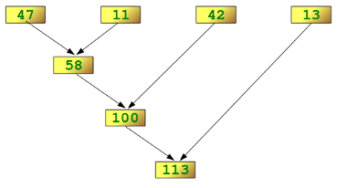
Reducing a List
>>> import functools
>>> functools.reduce(lambda x,y: x+y, [47,11,42,13])
113
>>>

Slide 91
Examples of reduce()
>>> from functools import reduce
>>> f = lambda a,b: a if (a > b) else b
>>> reduce(f, [47,11,42,102,13])
102
>>> from functools import reduce
>>> reduce(lambda x, y: x+y, range(1,101))
5050

Slide 92
Datetime module
A Python program can handle date and time in several ways. Converting between date formats is a common chore for computers. Python's time and calendar modules help track dates and times.
There is a popular time module available in Python which provides functions for working with times, and for converting between representations. The function time.time() returns the current system time in ticks since 12:00am, January 1, 1970(epoch).
#Example import time; # This is required to include time module. ticks = time.time() print ("Number of ticks since 12:00am, January 1, 1970:", ticks)
#Number of ticks since 12:00am, January 1, 1970: 1503842085.9712768

Slide 93
TimeTuple
Index | Field | Values
0 | 4-digit year | 2016
1 | Month | 1 to 12
2 | Day | 1 to 31
3 | Hour | 0 to 23
4 | Minute | 0 to 59
5 | Second | 0 to 61 (60 or 61 are leap-seconds)
6 | Day of Week | 0 to 6 (0 is Monday)
7 | Day of year | 1 to 366 (Julian day)
8 | Daylight savings | -1, 0, 1, -1 means library determines DST
Many of the Python's time functions handle time as a tuple of 9 numbers
>>> import time
>>> print(time.localtime())
time.struct_time(tm_year=2017, tm_mon=8, tm_mday=27, tm_hour=19, tm_min=18, tm_sec=56, tm_wday=6, tm_yday=239, tm_isdst=0)

Slide 94
Getting formatted time
#!/usr/bin/python3 import time localtime = time.asctime( time.localtime(time.time()) ) print ("Local current time :", localtime)
#Local current time : Sun Aug 27 19:23:11 2017

Slide 95
Getting calendar for a month
#!/usr/bin/python3 import calendar cal = calendar.month(2016, 2) print ("Here is the calendar:") print (cal)
Here is the calendar:
February 2016
Mo Tu We Th Fr Sa Su
1 2 3 4 5 6 7
8 9 10 11 12 13 14
15 16 17 18 19 20 21
22 23 24 25 26 27 28
29

Slide 96
Working Example with Datetime
from datetime import date from datetime import datetime from datetime import timedelta # construct a basic timedelta and print it print(timedelta(days=365, hours=8, minutes=15)) # print today's date print("today is: " + str(datetime.now())) # print today's date one year from now print("one year from now it will be:" + str(datetime.now() + timedelta(days=365))) today = date.today() # get todays date nyd = date(today.year, 1, 1) # get New Year Day for the same year # use date comparison to see if New Year Day has already gone for this year # if it has, use the replace() function to get the date for next year if nyd < today: print("New Year day is already went by %d days ago" % ((today - nyd).days))

Slide 97
Random Module in Python
The random module provides access to functions that support many operations. Perhaps the most important thing is that it allows you to generate random numbers.
When to use it?
We want the computer to pick a random number in a given range
Pick a random element from a list, pick a random card from a deck, flip a coin etc.
When making your password database more secure or powering a random page feature of your website.

Slide 98
Randint
If we wanted a random integer, we can use the randint function Randint accepts two parameters: a lowest and a highest number.
Example : Generate integers between 1,5. The first value should be less than the second.
import random print (random.randint(0, 5)) # This will output either 1, 2, 3, 4 or 5.

Slide 99
Random & Choice
If you want a larger number, you can multiply it.
Example: Random number between 0 and 100:
import random print(random.random() * 100)
Generate a random value from the sequence sequence.
random.choice( ['red', 'black', 'green'] ).
The choice function can often be used for choosing a random element from a list.
import random myList = [2, 109, False, 10, "Lorem", 482, "Ipsum"] print(random.choice(myList))

Slide 100
Shuffle & Randrange
The shuffle function, shuffles the elements in list in place, so they are in a random order.
Randrange generate a randomly selected element from range(start, stop, step)
Example
from random import shuffle x = [[i] for i in range(10)] shuffle(x)
import random for i in range(3): print (random.randrange(0, 101, 5))

Slide 101
JSON Module in Python
In Python, the json module provides an API similar to convert in-memory Python objects to a serialized representation known as JavaScript Object Notation (JSON) and vice-a-versa.
Python | JSON
dict | object
list, tuple | array
str | string
int, float, int- & float-derived Enums | number
True | true
False | false
None | null

Slide 102
Encode Python objects as JSON strings
json.dump(obj, fp, skipkeys=False, ensure_ascii=True, check_circular=True, allow_nan=True, cls=None, indent=None, separators=None, default=None, sort_keys=False, **kw)
Notes:
The default value of skipkeys is False. If skipkeys is True, then dict keys that are not of a basic type (str, int, float, bool, None) will be skipped instead of raising a TypeError.
The json module always produces str objects, not bytes objects. Therefore, fp.write() must support str input.
If ensure_ascii is True (the default), the output is guaranteed to have all incoming non-ASCII characters escaped. If ensure_ascii is False, these characters will be output as-is.
The default value of check_circular is True. If check_circular is False, then the circular reference check for container types will be skipped and a circular reference will result in an OverflowError.
The default value of allow_nan is True. If allow_nan is False, then it will be a ValueError to serialize out of range float values (nan, inf, -inf) in strict compliance with the JSON specification, instead of using the JavaScript equivalents (NaN, Infinity, -Infinity).
If indent is a non-negative integer or string, then JSON array elements and object members will be pretty-printed with that indent level. An indent level of 0, negative, or "" will only insert newlines. None (the default) selects the most compact representation. Using a positive integer indent indents that many spaces per level. If indent is a string (such as "\t"), that string is used to indent each level.
Use (',', ': ') as default if indent is not None.
The default value of sort_keys is False. If sort_keys is True, then the output of dictionaries will be sorted by key.

Slide 103
Python Dictionaries to JSON strings
import json student = {"101": {"class": 'V', "Name": 'Rohit', "Roll_no": 7}, "102": {"class": 'V', "Name": 'David', "Roll_no": 8}, "103": {"class": 'V', "Name": 'Samiya', "Roll_no": 12}} print(json.dumps(student));
Output:
{
"103": {"class": "V", "Name": "Samiya", "Roll_no": 12},
"102": {"class": "V", "Name": "David", "Roll_no": 8},
"101": {"class": "V", "Name": "Rohit", "Roll_no": 7}
}

Slide 104
Python Dictionaries to JSON strings (sorted by key)
import json student = {"103":{"class":'V', "Name":'Rohit', "Roll_no":7}, "102":{"class":'V', "Name":'David', "Roll_no":8}, "101":{"class":'V', "Name":'Samiya', "Roll_no":12}} print(json.dumps(student, sort_keys=True));
Output:
{
"101": {"Name": "Rohit", "Roll_no": 7, "class": "V"},
"102": {"Name": "David", "Roll_no": 8, "class": "V"},
"103": {"Name": "Samiya", "Roll_no": 12, "class": "V"}
}

Slide 105
Python tuple & List to JSON array
import json tup1 = 'Red', 'Black', 'White'; print(json.dumps(tup1)); list1 = [5, 12, 13, 14]; print(json.dumps(list1));

Slide 106
Decode JSON strings into Python objects
import json json_data = '{
"103": {"class": "V", "Name": "Samiya", "Roll_n": 12},
"102": {"class": "V", "Name": "David", "Roll_no": 8},
"101": {"class": "V", "Name": "Rohit", "Roll_no": 7}
}'; print(json.loads(json_data));

Slide 107
Working with Excel
Excel is a popular and powerful spreadsheet application for Windows. The openpyxl module allows your Python programs to read and modify Excel spreadsheet files.
For example,
you might have the boring task of copying certain data from one spreadsheet and pasting it into another one
you might have to go through thousands of rows and pick out just a handful of them to make small edits based on some criteria.
you might have to look through hundreds of spreadsheets of department budgets, searching for any that are in the red.
Although Excel is proprietary software from Microsoft, there are free alternatives that run on Windows, OS X, and Linux. Both LibreOffice Calc and OpenOffice Calc work with Excel’s .xlsx file format for spreadsheets, which means the openpyxlmodule can work on spreadsheets from these applications as well.

Slide 108
Installing the openpyxl Module
Python does not come with OpenPyXL, so you’ll have to install it.
Pip comment you need to use for installation
pip install openpyxl

Slide 109
Opening Excel Documents with OpenPyXL
>>> import openpyxl >>> wb = openpyxl.load_workbook(‘D:\example.xlsx') >>> print(wb) <class 'openpyxl.workbook.workbook.Workbook'>

Slide 110
Getting Sheets from the Workbook
import openpyxl wb = openpyxl.load_workbook('D:\example.xlsx') print(wb.get_sheet_names()) #['Sheet1', 'Sheet2', 'Sheet3'] sheet = wb.get_sheet_by_name('Sheet3') print(sheet) #<Worksheet "Sheet3"> print(sheet.title) #'Sheet3' anotherSheet = wb.active print(anotherSheet) #<Worksheet "Sheet1">

Slide 111
Getting Cells from the Sheets
import openpyxl wb = openpyxl.load_workbook(‘D:\example.xlsx') sheet = wb.get_sheet_by_name('Sheet1') print(sheet['A1']) #<Cell Sheet1.A1> print(sheet['A1'].value) #datetime.datetime(2015, 4, 5, 13, 34, 2) c = sheet['B1'] print(c.value) #'Apples' print('Row ' + str(c.row) + ', Column ' + c.column + ' is ' + c.value) #'Row 1, Column B is Apples' print('Cell ' + c.coordinate + ' is ' + c.value) #'Cell B1 is Apples' print(sheet[‘D3'].value) 73

Slide 112
Working with Database

Slide 113
Python Database Access
The Python standard for database interfaces is the Python DB-API. Most Python database interfaces adhere to this standard.
You can choose the right database for your application. Python Database API supports a wide range of database servers such as
GadFly
mSQL
MySQL
PostgreSQL
Microsoft SQL Server 2000
Informix
Interbase
Oracle
Sybase
SQLite

Slide 114
Python with MySQL
pymysql is an interface for connecting to a MySQL database server from Python
It implements the Python Database API v2.0 and contains a pure-Python MySQL client library.
The goal of pymysql is to be a drop-in replacement for MySQLdb which was supported 2.7.
Install PyMySQL
pip install pymysql

Slide 115
Database Connection
#!/usr/bin/python3 import pymysql # Open database connection db = pymysql.connect("localhost","root","root","trainingdb" ) # prepare a cursor object using cursor() method cursor = db.cursor() # execute SQL query using execute() method. cursor.execute("SELECT VERSION()") # Fetch a single row using fetchone() method. data = cursor.fetchone() print ("Database version : %s " % data) # disconnect from server db.close()

Slide 116
Creating Database Table
#!/usr/bin/python3 import pymysql # Open database connection db = pymysql.connect("localhost","root","root","trainingdb" ) # prepare a cursor object using cursor() method cursor = db.cursor() # Drop table if it already exist using execute() method. cursor.execute("DROP TABLE IF EXISTS EMPLOYEE") # Create table as per requirement sql = """CREATE TABLE EMPLOYEE ( FIRST_NAME CHAR(20) NOT NULL, LAST_NAME CHAR(20), AGE INT, SEX CHAR(1), INCOME FLOAT )""" cursor.execute(sql) # disconnect from server db.close()

Slide 117
INSERT Operation
#!/usr/bin/python3 import pymysql # Open database connection db = pymysql.connect("localhost","root","root","trainingdb" ) # prepare a cursor object using cursor() method cursor = db.cursor() # Prepare SQL query to INSERT a record into the database. sql = "INSERT INTO EMPLOYEE(FIRST_NAME, \ LAST_NAME, AGE, SEX, INCOME) \ VALUES ('%s', '%s', '%d', '%c', '%d' )" % \ ('Mac', 'Mohan', 20, 'M', 2000) try: # Execute the SQL command cursor.execute(sql) # Commit your changes in the database db.commit() except: # Rollback in case there is any error db.rollback() # disconnect from server db.close()

Slide 118
READ Operation
You can use either fetchone() method to fetch a single record or fetchall() method to fetch multiple values from a database table.
fetchone() − It fetches the next row of a query result set. A result set is an object that is returned when a cursor object is used to query a table.
fetchall() − It fetches all the rows in a result set. If some rows have already been extracted from the result set, then it retrieves the remaining rows from the result set.
rowcount − This is a read-only attribute and returns the number of rows that were affected by an execute() method.

Slide 119
# importing pymysql and connecting to database # Prepare SQL query to INSERT a record into the database. sql = "SELECT * FROM EMPLOYEE \ WHERE INCOME > {}" .format (1000) try: # Execute the SQL command cursor.execute(sql) # Fetch all the rows in a list of lists. results = cursor.fetchall() for row in results: fname = row[0] lname = row[1] age = row[2] sex = row[3] income = row[4] # Now print fetched result print ("fname = {},lname = {},age = {},sex = {},income = {}".format (fname, lname, age, sex, income )) except: print ("Error: unable to fetch data") # disconnect from server db.close()
Read Operation
With

Slide 120
import pymysql as mdb
con = mdb.connect('localhost', 'root', 'root', 'testdb')
with con:
cur = con.cursor(mdb.cursors.DictCursor)
cur.execute("SELECT * FROM Writers LIMIT 4")
rows = cur.fetchall()
for row in rows:
print row["Id"], row["Name"]
Dictionary cursor

Slide 121
#!/usr/bin/python3 import pymysql # Open database connection db = pymysql.connect("localhost","root","root","trainingdb" ) # prepare a cursor object using cursor() method cursor = db.cursor() # Prepare SQL query to UPDATE required records sql = "UPDATE EMPLOYEE SET AGE = AGE + 5 \ WHERE SEX = {}".format ('M') try: # Execute the SQL command cursor.execute(sql) # Commit your changes in the database db.commit() except: # Rollback in case there is any error db.rollback() # disconnect from server db.close()
Update Operation

Slide 122
#!/usr/bin/python3 import pymysql # Open database connection db = pymysql.connect("localhost","root","root","trainingdb" ) # prepare a cursor object using cursor() method cursor = db.cursor() # Prepare SQL query to DELETE required records sql = "DELETE FROM EMPLOYEE WHERE AGE > {}".format (20) try: # Execute the SQL command cursor.execute(sql) # Commit your changes in the database db.commit() except: # Rollback in case there is any error db.rollback() # disconnect from server db.close()
Delete Operation

Slide 123
Working with ZIP
With zip we can act upon two lists at once.
We pass it two iterables, like lists, and it enumerates them together.
Zip object. Zip does not return a list. Instead it returns a special, optimized collection called a "zip object."
With zip objects, we can loop over tuples of the elements. But we cannot access elements by indexes or use len. We must loop over our zip objects.
Function zip() is a built-in function for it.

Slide 124
List Example
Equal length.
items1 = ["blue", "red", "green", "white"] items2 = ["sky", "sunset", "lawn", "pillow"] # Zip the two lists and access pairs together. for item1, item2 in zip(items1, items2): print(item1, "...", item2)
blue ... sky
red ... sunset
green ... lawn
white ... pillow
Unequal length.
list1 = [10, 20, 30, 40] list2 = [11, 21, 31] # Zip the two lists. result = zip(list1, list2) # The zipped result is only 3 elements long. # ... The fourth element of list1 was discarded. for element1, element2 in result: print(element1, element2)
10 11
20 21
30 31

Slide 125
Logging in Python 3
The logging module is part of the standard Python library and provides tracking for events that occur while software runs.
You can add logging calls to your code to indicate what events have happened.
The logging module allows for both diagnostic logging that records events related to an application’s operation, as well as audit logging which records the events of a user’s transactions for analysis.

Slide 126
Before Logging
class Pizza(): def __init__(self, name, price): self.name = name self.price = price print("Pizza created: {} (${})".format(self.name, self.price)) def make(self, quantity=1): print("Made {} {} pizza(s)".format(quantity, self.name)) def eat(self, quantity=1): print("Ate {} pizza(s)".format(quantity, self.name)) pizza_01 = Pizza("artichoke", 15) pizza_01.make() pizza_01.eat() pizza_02 = Pizza("margherita", 12) pizza_02.make(2) pizza_02.eat()

Slide 127
After Logging
import logging logging.basicConfig(level=logging.DEBUG) class Pizza(): def __init__(self, name, price): self.name = name self.price = price logging.debug("Pizza created: {} (${})".format(self.name, self.price)) def make(self, quantity=1): logging.debug("Made {} {} pizza(s)".format(quantity, self.name)) def eat(self, quantity=1): logging.debug("Ate {} pizza(s)".format(quantity, self.name)) pizza_01 = Pizza("artichoke", 15) pizza_01.make() pizza_01.eat() pizza_02 = Pizza("margherita", 12) pizza_02.make(2) pizza_02.eat()

Slide 128
Logging Messages to a File
import logging logging.basicConfig(filename="test.log",
level=logging.DEBUG, format="%(asctime)s:%(levelname)s:%(message)s") class Pizza(): def __init__(self, name, price): self.name = name self.price = price logging.debug("Pizza created: {} (${})".format(self.name, self.price)) def make(self, quantity=1): logging.debug("Made {} {} pizza(s)".format(quantity, self.name)) def eat(self, quantity=1): logging.debug("Ate {} pizza(s)".format(quantity, self.name)) pizza_01 = Pizza("artichoke", 15) pizza_01.make() pizza_01.eat()

Slide 129
Logging Levels
Level | Numeric Value | Function | Used to
CRITICAL | 50 | logging.critical() | Show a serious error, the program may be unable to continue running
ERROR | 40 | logging.error() | Show a more serious problem
WARNING | 30 | logging.warning() | Indicate something unexpected happened, or could happen
INFO | 20 | logging.info() | Confirm that things are working as expected
DEBUG | 10 | logging.debug() | Diagnose problems, show detailed information

Slide 130
Create a Python Package
Working with Python packages is really simple. All you need to do is:
Create a directory and give it your package's name.
Put your classes in it.
Create a __init__.py file in the directory
Lets do it practically

Slide 131
Working with Regular Expression
Python supports regular expressions through the standard python library re which is bundled with every Python installation.
While this library isn't completely PCRE compatible, it supports the majority of common use cases for regular expressions.

Slide 132
Raw Python strings
When writing regular expression in Python, it is recommended that you use raw strings instead of regular Python strings.
Raw strings begin with a special prefix (r) and signal Python not to interpret backslashes and special metacharacters in the string, allowing you to pass them through directly to the regular expression engine.
This means that a pattern like "\n\w" will not be interpreted and can be written as r"\n\w" instead of "\\n\\w" as in other languages, which is much easier to read.

Slide 133
Matching a string
The re package has a number of top level methods, and to test whether a regular expression matches a specific string in Python, you can use re.search().
This method either returns None if the pattern doesn't match, or a re.MatchObject with additional information about which part of the string the match was found.
>>> import re
>>> x = re.search("cat","A cat and a rat can't be friends.")
>>> print(x)
<_sre.SRE_Match object at 0x7fd4bf238238>
>>> x = re.search("cow","A cat and a rat can't be friends.")
>>> print(x)
None

Slide 134
Predefined Character Classes
. | whhich is used like a placeholder for "any character"
\d | Matches any decimal digit; equivalent to the set [0-9].
\D | The complement of \d. It matches any non-digit character; equivalent to the set [^0-9].
\s | Matches any whitespace character; equivalent to [ \t\n\r\f\v].
\S | The complement of \s. It matches any non-whitespace character; equiv. to [^ \t\n\r\f\v].
\w | Matches any alphanumeric character; equivalent to [a-zA-Z0-9_]. With LOCALE, it will match the set [a-zA-Z0-9_] plus characters defined as letters for the current locale.
\W | Matches the complement of \w.
\b | Matches the empty string, but only at the start or end of a word.
\B | Matches the empty string, but not at the start or end of a word.
\\ | Matches a literal backslash.

Slide 135
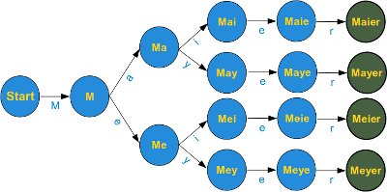
Character Classes
Square brackets, "[" and "]", are used to include a character class. [xyz] means e.g. either an "x", an "y" or a "z".
Example r"M[ae][iy]er"

Slide 136
Matching Beginning and End
>>> import re
>>> line = "He is a German called Mayer."
>>> if re.search(r"M[ae][iy]er",line): print("I found one!")
...
I found one!
>>>

Slide 137
Optional Items
If you thought that our collection of Mayer names was complete, you were wrong. There are other ones all over the world, e.g. London and Paris, who dropped their "e". So we have four more names ["Mayr", "Meyr", "Meir", "Mair"] plus our old set ["Mayer", "Meyer", "Meier", "Maier"]. If we try to figure out a fitting regular expression, we realize that we miss something. A way to tell the computer "this "e" may or may not occur". A question mark is used as a notation for this. A question mark declares that the preceding character or expression is optional.
The final Mayer-Recognizer looks now like this:
r"M[ae][iy]e?r"

Slide 138
Quantifiers
A quantifier after a token, which can be a single character or group in brackets, specifies how often that preceding element is allowed to occur. The most common quantifiers are
the question mark ?
the asterisk or star character *, which is derived from the Kleene star
and the plus sign +, derived from the Kleene cross
r"[0-9]*" | expression matches any sequence of digits, even the empty string
r"^[0-9]+ " | The plus operator is very similar to the star operator, except that the character or subexpression followed by a "+" sign has to be repeated at least one time

Slide 139
Example
import re regex = r"([a-zA-Z]+) (\d+)" if re.search(regex, "June 24"): match = re.search(regex, "June 24") # Match at index 0, 7 print( "Match at index %s, %s" % (match.start(), match.end())) # So this will print "June 24" print("Full match: %s" % (match.group(0))) # So this will print "June" print("Month: %s" % (match.group(1))) # So this will print "24" print("Day: %s" % (match.group(2))) else: # If re.search() does not match, then None is returned print("The regex pattern does not match. :(")

Slide 140
Example
import re # Lets use a regular expression to match a few date strings. regex = r"[a-zA-Z]+ \d+" matches = re.findall(regex, "June 24, August 9, Dec 12") for match in matches: print ("Full match: %s" % (match)) regex = r"([a-zA-Z]+) \d+" matches = re.findall(regex, "June 24, August 9, Dec 12") for match in matches: print ("Match month: %s" % (match)) # If we need the exact positions of each match regex = r"([a-zA-Z]+) \d+" matches = re.finditer(regex, "June 24, August 9, Dec 12") for match in matches: print ("Match at index: %s, %s" % (match.start(), match.end()))

Slide 141
Python Multithreaded Programming
Running several threads is similar to running several different programs concurrently, but with the following benefits −
Multiple threads within a process share the same data space with the main thread and can therefore share information or communicate with each other more easily than if they were separate processes.
Threads sometimes called light-weight processes and they do not require much memory overhead; they are cheaper than processes.
A thread has a beginning, an execution sequence, and a conclusion. It has an instruction pointer that keeps track of where within its context it is currently running.
It can be pre-empted (interrupted)
It can temporarily be put on hold (also known as sleeping) while other threads are running - this is called yielding.

Slide 142
Types of Threads
There are two different kind of threads −
kernel thread
user thread
Kernel Threads are a part of the operating system, while the User-space threads are not implemented in the kernel.
There are two modules which support the usage of threads in Python3
_thread
threading
The thread module has been "deprecated" for quite a long time. Users are encouraged to use the threading module instead. Hence, in Python 3, the module "thread" is not available anymore. However, it has been renamed to "_thread" for backwards compatibilities in Python3.

Slide 143
Starting a New Thread
#!/usr/bin/python3 import _thread import time # Define a function for the thread def print_time( threadName, delay): count = 0 while count < 5: time.sleep(delay) count += 1 print ("%s: %s" % ( threadName, time.ctime(time.time()) )) # Create two threads as follows try: _thread.start_new_thread( print_time, ("Thread-1", 2, ) ) _thread.start_new_thread( print_time, ("Thread-2", 4, ) ) except: print ("Error: unable to start thread") while 1: pass

Slide 144
The Threading Module
The newer threading module included with Python 2.4 provides much more powerful, high-level support for threads than the thread module discussed previously.
The threading module exposes all the methods of the thread module and provides some additional methods −
threading.activeCount() − Returns the number of thread objects that are active.
threading.currentThread() − Returns the number of thread objects in the caller's thread control.
threading.enumerate() − Returns a list of all thread objects that are currently active.

Slide 145
The Threading Module continue…
In addition to the methods, the threading module has the Thread class that implements threading. The methods provided by the Thread class are as follows −
run() − The run() method is the entry point for a thread.
start() − The start() method starts a thread by calling the run method.
join([time]) − The join() waits for threads to terminate.
isAlive() − The isAlive() method checks whether a thread is still executing.
getName() − The getName() method returns the name of a thread.
setName() − The setName() method sets the name of a thread.

Slide 146
Creating Thread Using Threading Module
#!/usr/bin/python3 import threading import time exitFlag = 0 class myThread(threading.Thread): def __init__(self, threadID, name, counter): threading.Thread.__init__(self) self.threadID = threadID self.name = name self.counter = counter def run(self): print("Starting " + self.name) print_time(self.name, self.counter, 5) print("Exiting " + self.name) def print_time(threadName, delay, counter): while counter: if exitFlag: threadName.exit() time.sleep(delay) print("%s: %s" % (threadName, time.ctime(time.time()))) counter -= 1

Slide 147
Synchronizing Threads
The threading module provided with Python includes a simple-to-implement locking mechanism that allows you to synchronize threads. A new lock is created by calling the Lock() method, which returns the new lock.
The acquire(blocking) method of the new lock object is used to force the threads to run synchronously. The optional blocking parameter enables you to control whether the thread waits to acquire the lock.
def run(self): print ("Starting " + self.name) # Get lock to synchronize threads threadLock.acquire() print_time(self.name, self.counter, 3) # Free lock to release next thread threadLock.release()

Slide 148
Multithreaded Priority Queue
The Queue module allows you to create a new queue object that can hold a specific number of items. There are following methods to control the Queue
get() − The get() removes and returns an item from the queue.
put() − The put adds item to a queue.
qsize() − The qsize() returns the number of items that are currently in the queue.
empty() − The empty( ) returns True if queue is empty; otherwise, False.
full() − the full() returns True if queue is full; otherwise, False.

Slide 149
Python performance tips
String Concatenation
Strings in Python are immutable. This fact frequently sneaks up and bites novice Python programmers on the rump. Immutability confers some advantages and disadvantages. In the plus column, strings can be used as keys in dictionaries and individual copies can be shared among multiple variable bindings. (Python automatically shares one- and two-character strings.) In the minus column, you can't say something like, "change all the 'a's to 'b's" in any given string. Instead, you have to create a new string with the desired properties. This continual copying can lead to significant inefficiencies in Python programs.
#Avoid this s = "" for x in list: s += some_function(x)
#Use this slist = [some_function(elt) for elt in somelist] s = "".join(slist)

Slide 150
Python performance tips
Loops
Python supports a couple of looping constructs. The for statement is most commonly used. It loops over the elements of a sequence, assigning each to the loop variable. If the body of your loop is simple, the interpreter overhead of the for loop itself can be a substantial amount of the overhead. This is where the map function is handy. You can think of map as a for moved into C code. The only restriction is that the "loop body" of map must be a function call. Besides the syntactic benefit of list comprehensions, they are often as fast or faster than equivalent use of map.
#Avoid this
newlist = [] for word in oldlist: newlist.append(word.upper())
#Use this newlist = map(str.upper, oldlist)

Slide 151
Python performance tips
Avoiding dots... (Local Variable)
Suppose you can't use map or a list comprehension? You may be stuck with the for loop. The for loop example has another inefficiency. Both newlist.append and word.upper are function references that are reevaluated each time through the loop. The original loop can be replaced with:
The final speedup available to us for the non-map version of the for loop is to use local variables wherever possible. If the above loop is cast as a function, append and upper become local variables. Python accesses local variables much more efficiently than global variables.
upper = str.upper newlist = [] append = newlist.append for word in oldlist: append(upper(word))

Slide 152
Python performance tips
Data Aggregation
Function call overhead in Python is relatively high, especially compared with the execution speed of a builtin function. This strongly suggests that where appropriate, functions should handle data aggregates.
#Avoid this import time x = 0 def doit1(i): global x x = x + i list = range(100000) t = time.time() for i in list: doit1(i) print ("%.3f" % (time.time()-t))
#Use this import time x = 0 def doit2(list): global x for i in list: x = x + i list = range(100000) t = time.time() doit2(list) print ("%.3f" % (time.time()-t))

Slide 153
Thank You
Q & A

